Slide 1
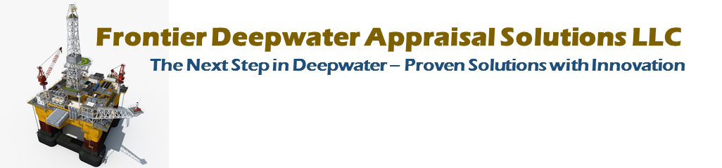
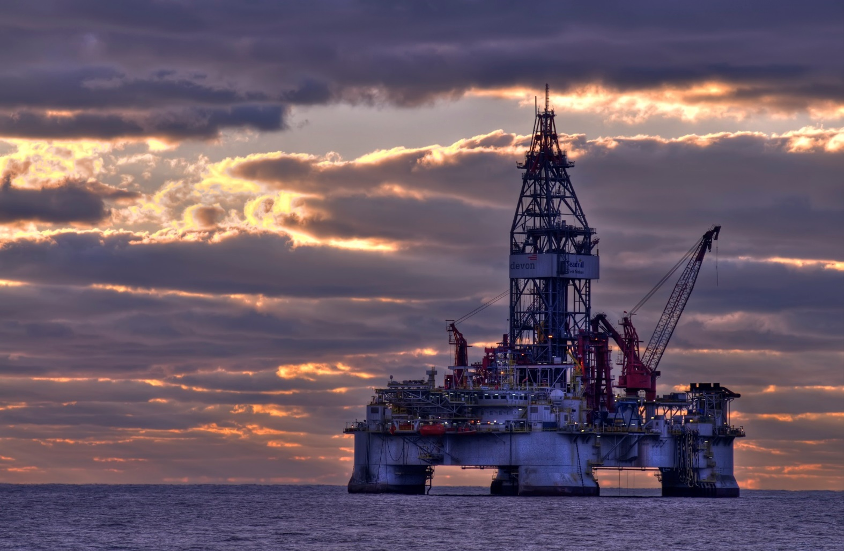
TOTAL gets COBALT assets
North Platte & Anchor in Wilcox, Navitas takes Shenandoah for $1.8m???
See news items and maps below
Providing:
Increased Safety
Improved Decision Quality
Improved Well Operations
Improved Reserves Recovery
with
Existing Technology Components, and
Greatly Reduced Costs and Risks
“An innovative engineering step change solution for the Paleogene - because the 20K Supply Chain cannot get us there.”
© Frontier Deepwater Appraisal Solutions LLC 2018
Notes:
First of all I would like to thank all of you for taking a look at our solution. After years of study, we believe it is the lowest cost and least risk approach to developing the Paleogene and other reservoirs in the GoM.
The idea was generated TO enable a Phased Approach to developing a Paleogene Asset, while at the same time providing the most robust configuration to allow for maximum well construction and reservoir maintenance capabilities:
Drilling, Completion and Sidetracks
Recompletion
Intervention and Survellienance
Repair
There is very little unqualified serial number one technology. Both GE and Dril-Quip currently have 15K dry tree equipment. There is a novel reconfiguration, but again we believe it is “PROVEN SOLUTIONS WITH INNOVATION.
We believe you can order this equipment today and have this producing in 3 to 4 years.

Slide 2
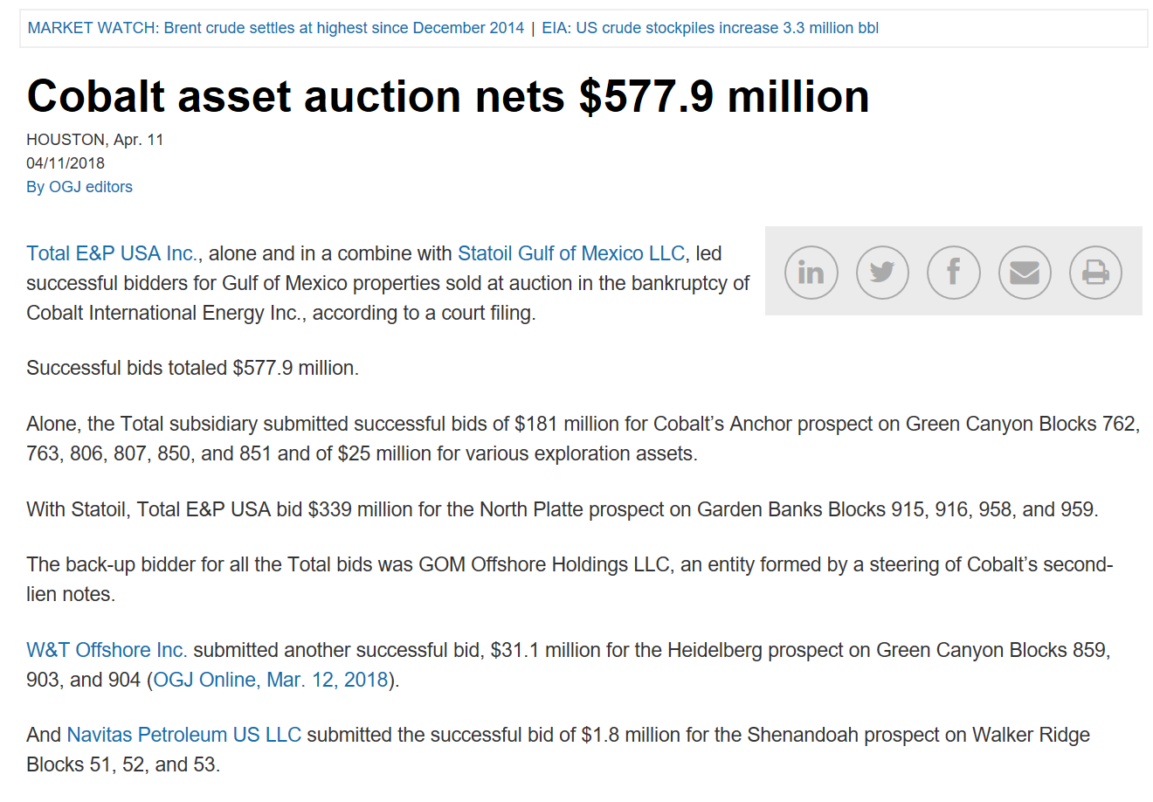

Slide 3
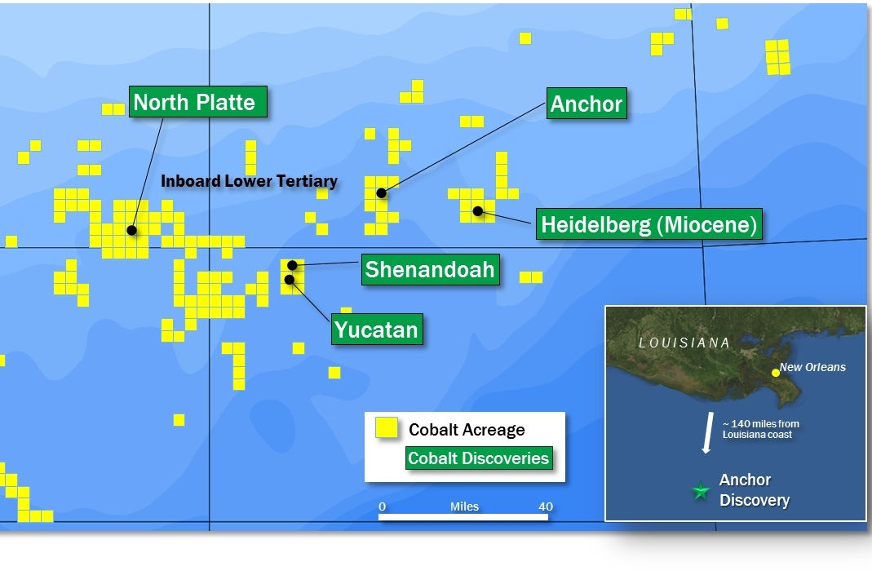

Slide 4
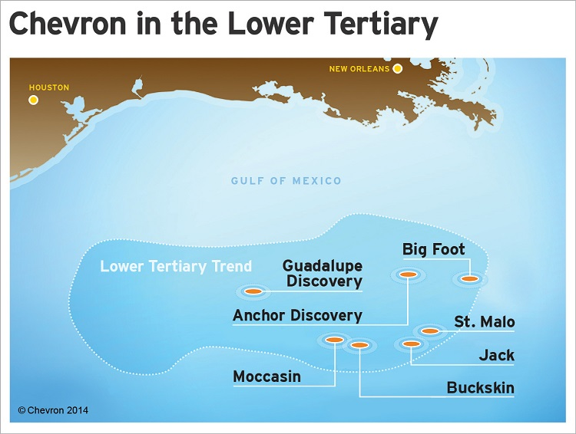
CVX failed to install the TLP in 1600m WD in June 2015
CVX gave up Buckskin-Moccasin 2015 to Repsol

Slide 5
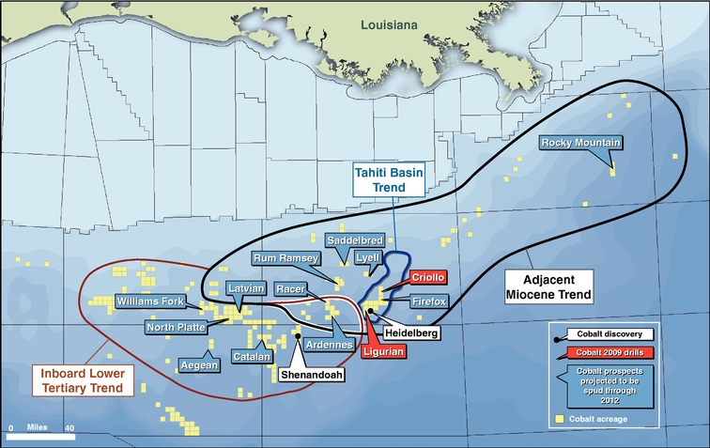

Slide 6
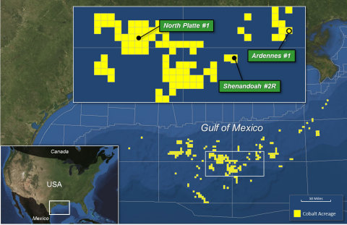

Slide 7
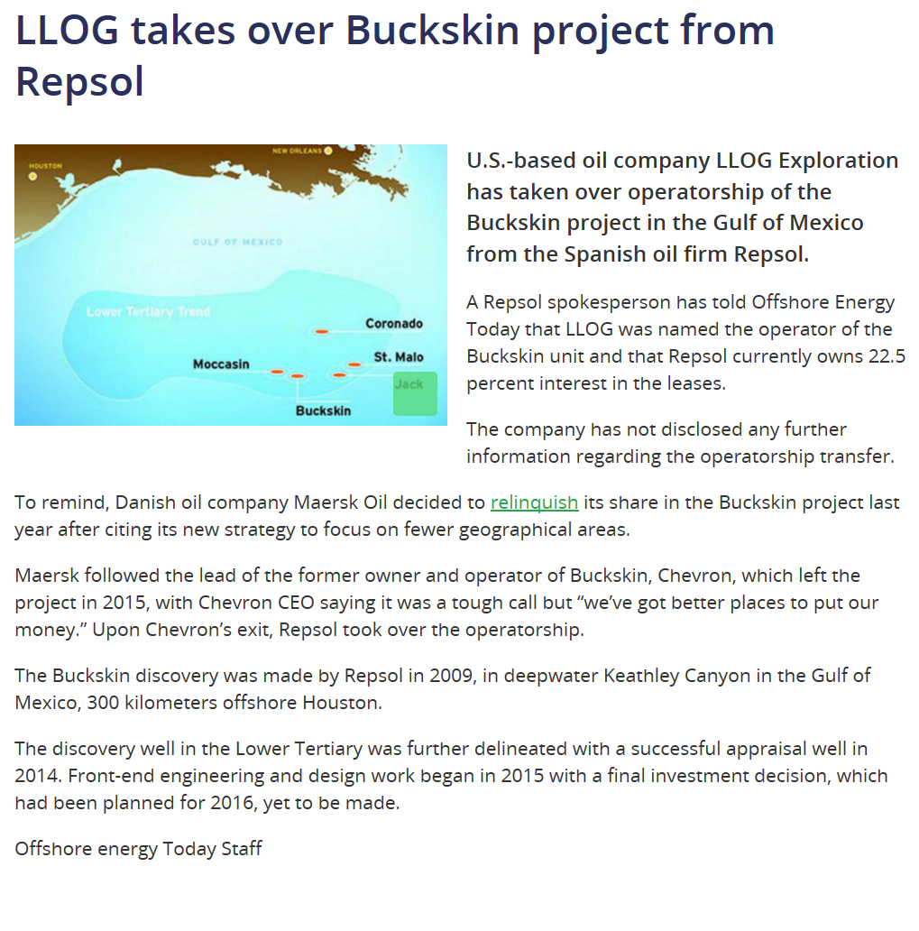
Jan 16, 2017

